Slide 1
Team 9
{Rupali,Sowmya}

Slide 2
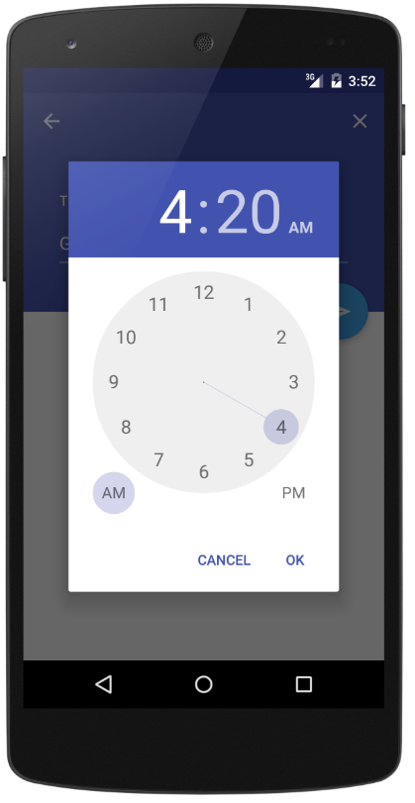
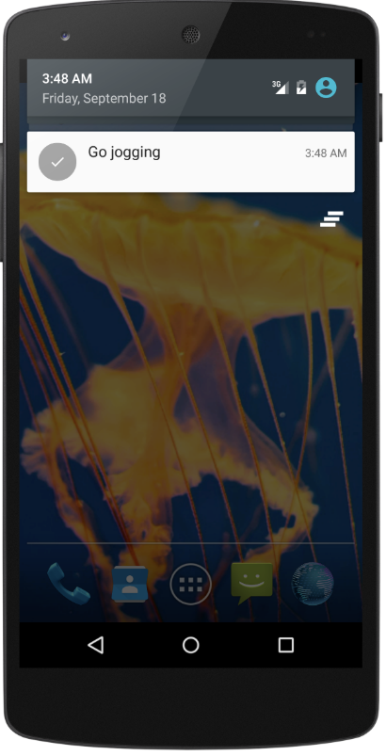
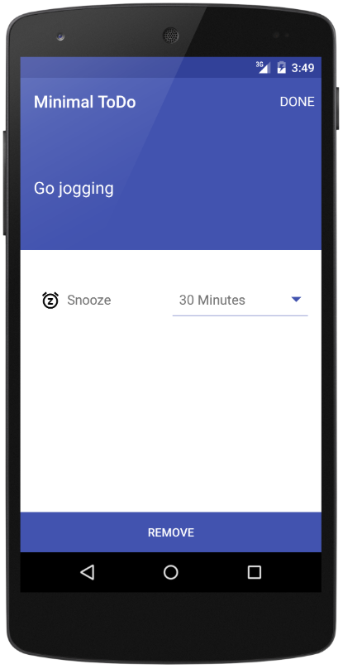
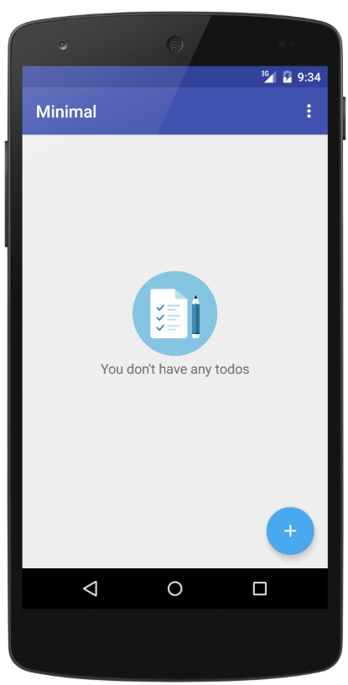
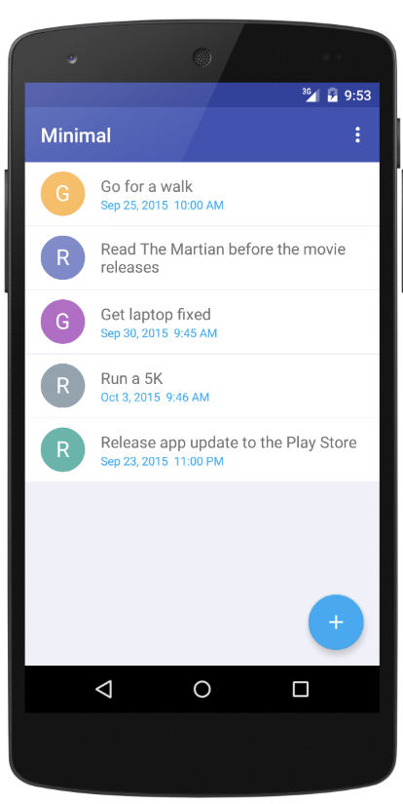
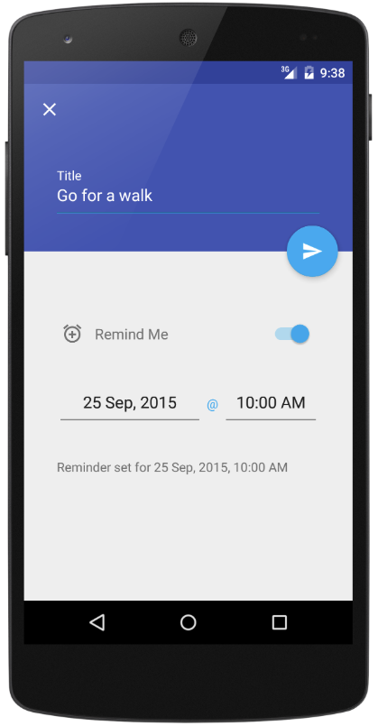
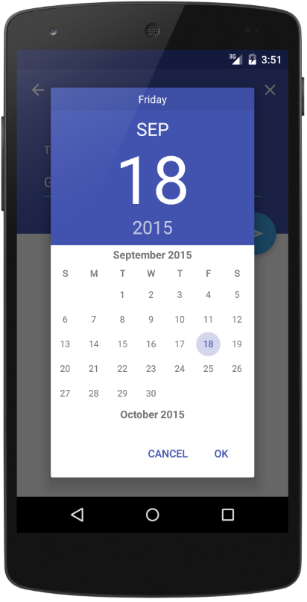
Android Minimal - TODO
https://github.com/avjinder/Minimal-Todo

Slide 3
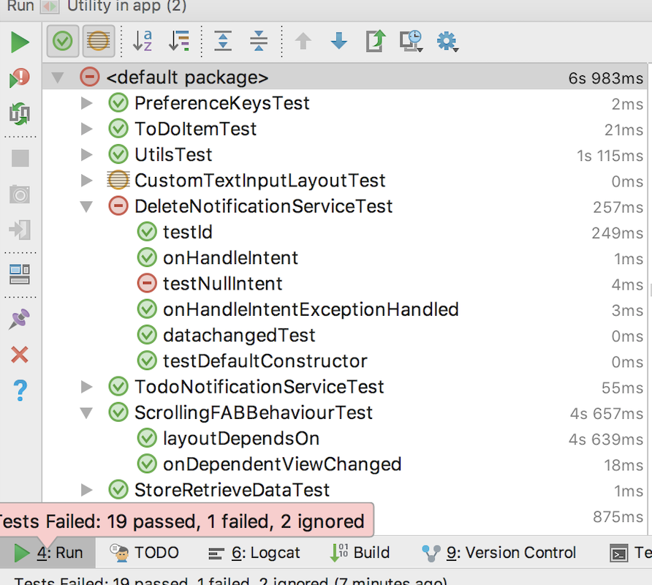
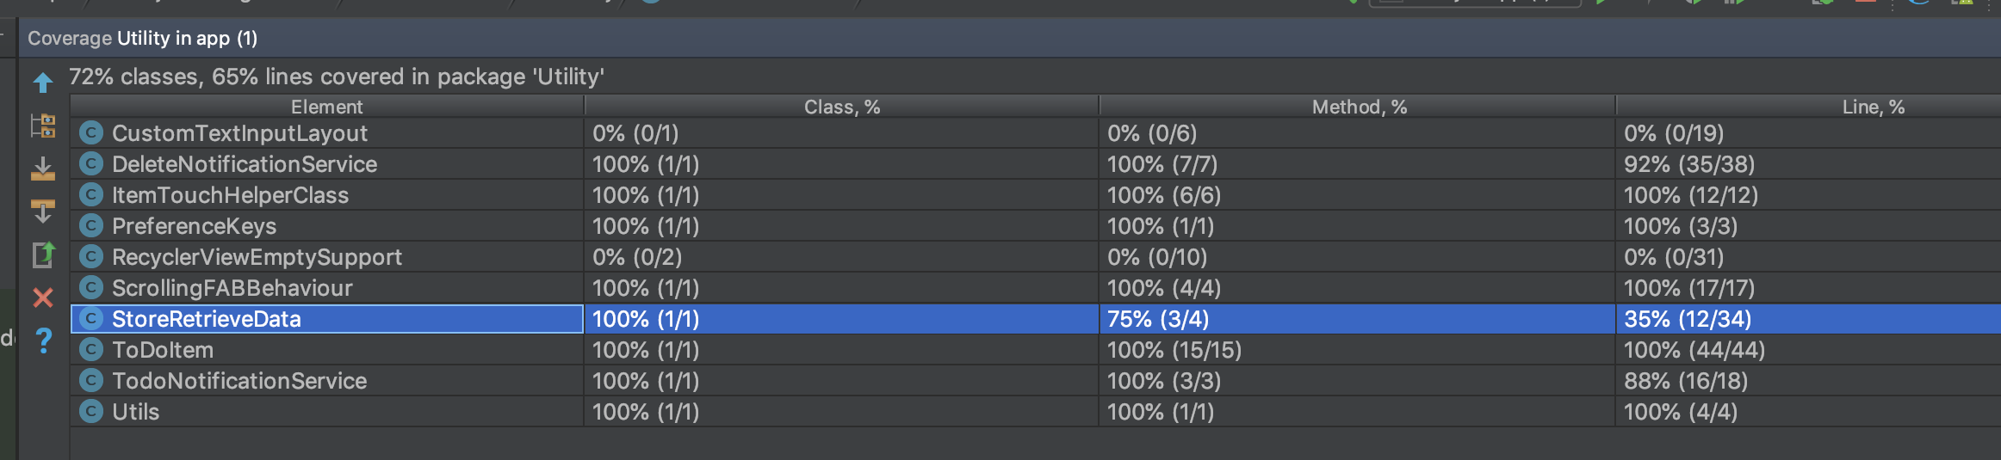
Unit Testing and Code Coverage

Slide 4
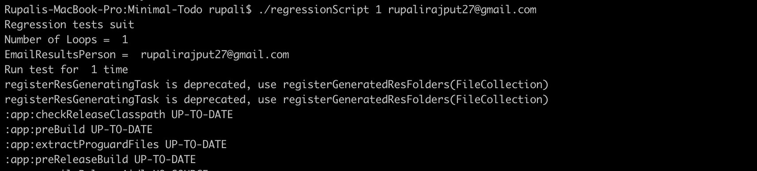
Regression Testing

Slide 5
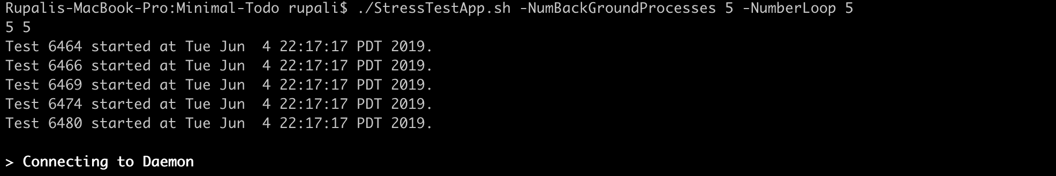
Stress Testing
The main goal of the stress testing was to reveal application bugs under high load conditions.
With this type of testing, we identified the application’s weak points such as synchronization issues, memory leaks, and race conditions.
Also, we covered different time frames:
a one-time short-term load on the system
./StressTestApp.sh -NumBackGroundProcesses 5 -NumberLoop 5 (It takes around 2mins)
a one-time long-term load on the system,
./StressTestApp.sh -NumBackGroundProcesses 100 -NumberLoop 100 (It takes around 115mins)
periodical short-term load on the system (In two separate windows)
./StressTestApp.sh -NumBackGroundProcesses 5 -NumberLoop 5 (Still It takes same time, around 2mins)
periodical long-term load on the system with a probability of failure of the system (In two separate windows)
./StressTestApp.sh -NumBackGroundProcesses 100 -NumberLoop 100 (Script started but then PC got crashed in sometime)

Slide 6
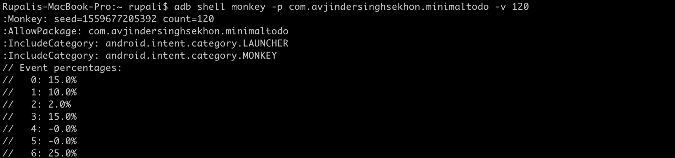
Monkey Testing
While doing this testing, we learned that it is an effective way to identify some out-of-the-box errors.
The randomness of monkey testing makes it a good way to find major bugs that can break the entire system.
The setup of monkey testing was quite easy. Its syntax : `adb shell monkey`
We ran this command from android shell environment: $ adb shell monkey [options] <event-count>
[options] = If we specify no options then it will send events to all any packages installed on your target, otherwise just mentioned package.
<event-count> = It is number of random events you want to send to it.

Slide 7
Experiences and Lessons Learned
We faced lot of challenges surrounding the infrastructure and using several tools for the first time while doing this android application testing.
Understood and utilized the use of mock objects, fake objects and then how to control the behavior of the mocks to test for all possible cases.
Another learning was to understand how to trigger and build test cases for the entire project.
Also, we learnt that tests are not a cover for badly written code. We had to change several classes to get them to be test compatible.

